Slide 1


CSE 455 Software Testing
Lecture 3
This course is offered to the students of students of BS Software Engineering who are enrolled in 8th semester

Slide 2
Course instructor Yella mehroze
yellamehroze@cuilahore.edu.pk

Slide 3
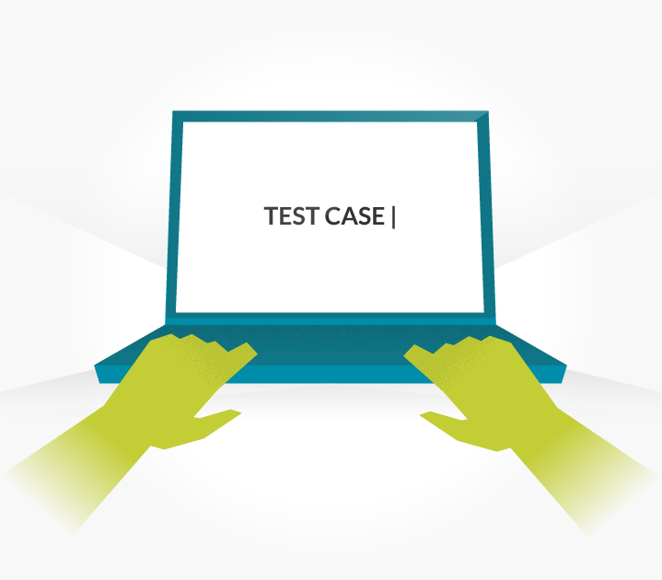
TEST CASES

Slide 4
Outline
Test Case
Test Case Template
Level of Detail For Test Case
Good Test Cases
Bad Test Cases
Test Case Organization and Tracking
Software Testing Life Cycle
SDLC Models and Testing
V-Model
Modified V-Model
Test Driven Development

Slide 5
Test Case
Test Case
A set of
Input values
Execution preconditions
Expected results
Execution post conditions
Developed for a particular objective or test condition, such as
To exercise a particular program path
To verify compliance with a specific requirement.

Slide 6
Test Case Template
Below are the standard fields of sample test case template
Test case ID:
Unique ID for each test case.
Follow some convention to indicate types of test. E.g. ‘TC_UI_1’ indicating ‘user interface test case #1’.
Product / Ver./ Module:
Mention product name.
Mention name of main module or sub module.
Mention version information of the product.
Test case Version: (Optional)
Mention the test case version number.
Use Case Reference(s):
Mention the use case reference for which the test case is written.

Slide 7
Test Case Template
GUI Reference(s) :(Optional)
Mention the GUI reference for which the test case is written.
QA Test Engineer / Test Designed By:
Name of the tester
Test Designed Date:
Date when test case is written.
Test Executed By:
Name of tester who executed this test.
To be filled after test execution.
Test Execution Date:
Date when test case is executed.

Slide 8
Test Case Template
Test Title/Name:
Test case title. E.g. verify login page with valid username and password.
Test Case Summary/Description:
Describe test objective.
Pre-Requisite/Pre-condition:
Any prerequisite that must be fulfilled before execution of this test case.
List all pre-conditions in order to successfully execute this test case.
Dependencies: (Optional)
Mention any dependencies on other test cases or test requirement.
Test Steps:
List all test execution steps in detail.
Write test steps in the order in which these should be executed.
Make sure to provide as much details as you can.

Slide 9
Test Case Template
Test Data/Input Specification:
Use of test data as an input for the test case.
You can provide different data sets with exact values to be used as an input.
Examples: If you’re testing Calculator, this may be as simple as 1+1.
If you’re testing cellular telephone switching software, there could be hundreds or thousands of input conditions.
If you’re testing a file-based product, it would be the name of the file and a description of its contents.
Expected Result/ Output Specification:
What should be the system output after test execution?
Describe the expected result in detail including message/error that should be displayed on screen.
Examples: Did 1+1 equal 2?
Were the thousands of output variables set correctly in the cell phone software?
Did all the contents of the file load as expected?

Slide 10
Test Case Template
Actual result:
Actual test result should be filled after test execution.
Describe system behaviour after test execution.
Status (Pass/Fail):
If actual result is not as per the expected result mark this test as failed.
Otherwise update as passed.
Notes/Comments/Questions: To support above fields if there are some special conditions which can’t be described in any of the above fields or there are questions related to the expected or actual results, mention those here.
Post-condition:
What should be the state of the system after executing this test case?

Slide 11
Test Case Template
Environmental needs: (Optional)
Environmental needs that are necessary to run the test case include:
Hardware
Software
Test tools
Facilities
Staff and so on.
Special procedural requirements: (Optional)
This section describes anything unusual that must be done to perform the test.
Example: Testing WordPad probably doesn’t need anything special, but testing nuclear power plant software might.

Slide 12
Level of Detail For Test Case
If you follow this level of documentation, you could be writing at least a page of descriptive text for each test case you identify.
Thousands of test cases could take thousands of pages of documentation.
The project could be outdated by the time you finish writing.
Many government projects and industries are required to document their test cases to this level.
In other cases, you can take some shortcuts.
Taking a shortcut doesn’t mean dismissing or neglecting important information.

Slide 13
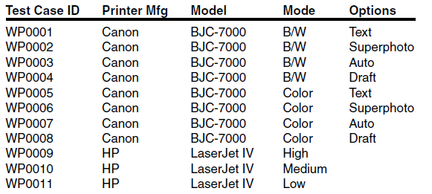
Level of Detail For Test Case
You can use the following test case format for printer compatibility matrix
All the other information that goes with a test case are most likely common to all these cases and could be written once and attached to the table

Slide 14
Good Test Cases
A good test case has certain characteristics which are:
Should be accurate and tests what it is intended to test.
No unnecessary steps should be included in it.
It should be reusable.
It should be traceable to requirements.
It should be compliant to regulations.
It should be simple and clear, any tester should be able to understand it by reading once.

Slide 15
TIPS for writing good test cases
Tests only one thing
Always make sure that your test case tests only one thing, if you try to test multiple conditions in one test case it becomes very difficult to track results and errors.
Organize your test cases consistently
You can organize your test cases in many ways however you should always follow the same pattern to organize you test cases.
Write independent test cases
Your test cases should not have dependency on other test cases, i.e. you should be able to execute your test case in any order without any dependency on other test cases
Write small test cases
Always mention purpose of each test case clearly.
Be precise.

Slide 16
Bad Test Cases
Test passes but not testing the actual feature
Testing irrelevant things
Testing multiple things in assertions
Tests swallowing exceptions
Test which depends on excessive setup
Test compatible to only developer's machine
Test filling log files with load of texts

Slide 17
Test Procedure
A standardized and documented process that represent the sequence of actions for the execution of test cases. Also known as manual test script.
The ANSI/IEEE 829 standard lists some important information that need to be defined
Identifier
A unique identifier that ties the test procedure to the associated test cases and test design.
Purpose
The purpose of the procedure and reference to the test cases that it will execute.
Special requirements
Other procedures, special testing skills, or special equipment needed to run the procedure.

Slide 18
Test Procedure
Procedure steps
Detailed description of how the tests are to be run:
Log- Tells how and by what method the results and observations will be recorded.
Setup- Explains how to prepare for the test.
Start- Explains the steps used to start the test.
Procedure- Describes the steps used to run the tests.
Measure- Describes how the results are to be determined—for example, with a stopwatch or visual determination.
Shut down- Explains the steps for suspending the test for unexpected reasons.
Restart- Tells the tester how to pick up the test at a certain point if there’s a failure or after shutting down.
Stop- Describes the steps for an orderly halt to the test.
Wrap up- Explains how to restore the environment to its pre-test condition.
Contingencies- Explains what to do if things don’t go as planned.

Slide 19
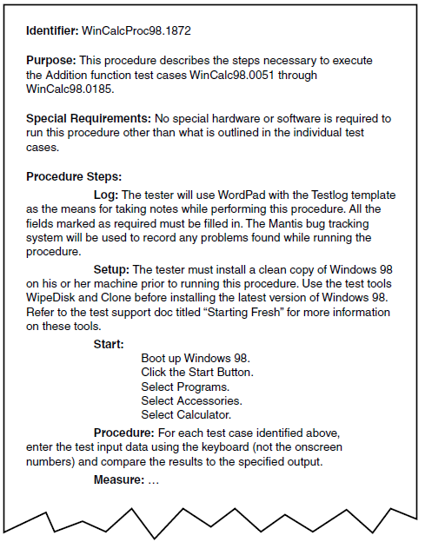
Test Procedure Showing How Much Detail Should Be Involved

Slide 20
Test Case Organization and Tracking
While considering how the information will be organized and tracked think about the questions:
Which test cases do you plan to run?
How many test cases do you plan to run?
How long will it take to run them?
Can you pick and choose test suites (groups of related test cases) to run on particular features or areas of the software?
When you run the cases, will you be able to record which ones pass and which ones fail?
Of the ones that failed, which ones also failed the last time you ran them?
What percentage of the cases passed the last time you ran them?

Slide 21
Test Case Organization and Tracking
To manage your test cases and track their results, there are essentially four possible systems
In your head
Don’t even consider this one even for the simplest projects
Paper/documents
It’s possible to manage the test cases for very small projects on paper.
Tables and charts of checklists have been used effectively.
Spreadsheet.
A popular and very workable method of tracking test cases is by using a spreadsheet
They’re
easy to use
relatively easy to set up
provide good tracking and proof of testing
Give quick overview

Slide 22
Test Case Organization and Tracking
Custom Database.
The ideal method for tracking test cases
Many commercial applications available to perform this specific task
You can set up reports and queries that would allow you to answer any question regarding the test cases.
The important thing to remember is that the number of test cases can easily be in the thousands and without a means to manage them, you and the other testers could quickly be lost in a sea of documentation

Slide 23
Testing Life Cycle
Project Initiation
Summary Reports
System Study
Analysis
Test Plan
Regression Test
Design Test Cases
Report Defects
Test Environment Setup
Execute Test Cases
( manual /automated )

Slide 24
Testing Life Cycle
Project Initiation
All the necessary analysis is undertaken to allow the project to be planned.
System Study
To test, we need to know the product functionality(Understanding the product)
Test Plan
It is a Systematic approach to test a system or s/w.
Contains a detailed understanding of what the eventual testing workflow will be or should be.
Design Test Cases:
Test case is the specific procedure of testing a particular requirement by giving specific input to the system and defining the expected results.
Executing(Manual):
Usually Test cases will be written by person A and will be executed by person B and vice-versa so that there are more chances to find bugs.

Slide 25
Testing Life Cycle
Report defects:
Reporting defects in Issue Logger (Ex: JIRA, HP-QC)
Issues will be fixed by the DEV team.
Regression testing:
Verify whether the new functionality or bug correction affected the previous behaviour
Analysis:
Analysis about the Testing is Done here.
Test Summary Report
An important deliverable which is prepared after Testing is completed.
This document is to explain various details and activities about the Testing performed for the Project, to the respective stakeholders like Senior Management, Client etc.

Slide 26
SDLC Models and Testing
Waterfall Model
Sees testing as Post Development (Post Coding) activity
Spiral Model
Tried to Breakup product in increments
Each of the increment can be tested separately
V-Model
Similar to Waterfall Model
Sees product development to be made up of number of phases or levels
Different types of testing is applied to different phases or levels

Slide 27
Product development activity represented as Waterfall Model
Overall Business Requirements
Software Requirements
High Level Design
Low Level Design
Coding
Testing

Slide 28
Phases of testing for different development phases
Overall Business Requirements
Acceptance Testing
Software Requirements
System Testing
High Level Design
Integration Testing
Low Level Design
Component Testing
Coding
Unit Testing
Testing

Slide 29
The V Model
Overall Business Requirement
These requirements cover hardware, software, and operational requirements
Software Requirements
Next step is moving from overall requirements to software requirements.
High Level Design
Software system is imagined as a set of sub systems that work together
Low Level Design
High level design gets translated to a more detailed or low level design. In this data structures, algorithms choices, table layouts, processing logics and exception conditions etc are decided
Coding
Program code is written in appropriate languages

Slide 30
The V Model
Acceptance Testing
For overall business requirements, eventually whatever software is developed should fit into and work in overall context and should be accepted by end user. This testing is acceptance testing
System Testing
Before product deployment, the product tested as an entire unit to make sure that all the software requirements are satisfied by the product. This testing of entire software system is system testing
Integration Testing
High level design views the system as being made up of interoperating and integrated subsystems. The individual subsystems should be integrated and tested. This type of testing corresponds to integration testing

Slide 31
The V Model
Component Testing
The components that are the outputs of low level design have to be tested independently before being integrated. This type of testing is component level testing
Unit Testing
Coding produces several program units, each of these units have to be tested independently before combining them to form components. The testing of program units form the unit testing

Slide 32
The V Model
Planning of testing for different development phases
Planning phase is not shown as a separate entity since it is common for all testing phases.
It is still not possible to execute any of these tests until the product is actually built.
In other words, the step called "testing" is now broken down into different sub-steps.
It is still the case that all the testing execution related activities are done only at the end of the life cycle.

Slide 33
The V Model
Who should design test
Execution of the tests cannot be done till the product is built, but the design of tests can be carried out much earlier.
Skill sets required for designing each type of tests,
The people who are actually performing the function of creating the corresponding artifact.
For example,
Acceptance tests should be designed by those who formulate the overall business requirements (the customers, where possible).
Those should design the integration tests who know how the system is broken into subsystems i.e. those who perform the high level design.
Again, the people doing development know the innards of the program code and thus are best equipped to design the unit tests.

Slide 34
The V Model
Benefits of early design
We achieve more parallelism and reduce the end-of-cycle time taken for testing.
By designing tests for each activity upfront, we are building in better upfront validation, thus again reducing last-minute surprises.
Tests are designed by people with appropriate skill sets.

Slide 35
V-Model
Overall Business Requirements
Acceptance Test Design
Acceptance Testing
Software Requirements
System Testing Design
System Testing
High Level Design
Integration Test Design
Integration Testing
Low Level Design
Component Test Design
Component Testing
Coding
Unit Test Design
Unit Testing
Verification
Validation

Slide 36
V-Model
Advantages of V- Model
Testing activities like planning, test designing happens well before coding.
This saves a lot of time hence higher chances of success over the waterfall model.
Proactive defect tracking – that is defects are found at early stage
it avoids the downward flow of the defects.
Dis-advantages of V-Model
It is Very rigid and least flexible.
No early prototypes of the software are produced.
If any changes happen in midway, then the test documents along with requirement documents has to be updated.

Slide 37
Modified V-Model
In the V-Model there is an assumption
Even the activity of test execution was split into execution of tests of different types, the execution cannot happen until the entire product is built.
For a given product, the different units and components can be in different stages of evolution
For example one unit may be in development and thus subject to unit testing whereas another unit may be ready for component testing
The V model does not explicitly address this parallelism commonly found in the product development

Slide 38
Modified V-Model
In the modified V Model,
Each unit or component or module is given explicit exit criteria to pass on to the subsequent stage
The units or components or modules that satisfy a given phase of testing move to the next phase of testing where possible.
They do not wait for all the units or components or modules to move from one phase of testing to another.

Slide 39
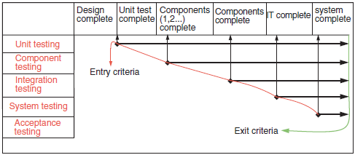
Modified V-Model

Slide 40
Test Driven Development
Test-driven development (TDD) is a method of software development
The concept is to "get something working now and perfect it later."
You develop the code incrementally, along with a test for that increment
Test-driven development was introduced as part of agile methods such as Extreme Programming
You don’t move on to the next increment until the code that you have developed passes its test

Slide 41
Test Driven Development
After each test, refactoring is done and then the same or a similar test is performed again.
Refactoring
Refactoring is the process of changing a software system in such a way that it does not alter the external behavior of the code yet improves its internal structure.
The testing is usually performed by an automated tool because:
You have to be able to run every test each time that you add functionality or refactor the program
The process is iterated as many times as necessary until each unit is functioning according to the desired specifications.
The tests are embedded in a separate program that runs the tests and invokes the system that is being tested
It is possible to run hundreds of separate tests in a few seconds

Slide 42
Test Driven Development
Procedure
Think about what you want to do.
Think about how to test it.
Write a small test.
Write just enough code to fail the test.
Run and watch the test fail.
Write just enough code to pass the test (and pass all your previous tests).
Run and watch all of the tests pass.
If you have any duplicate logic, or inexpressive code, refactor to remove duplication and increase expressiveness.
Run the tests again, It should Pass. If it Fails, then you made a mistake in your refactoring. Fix it now and re-run.
Repeat the steps above until you can't find any more tests that drive writing new code.

Slide 43
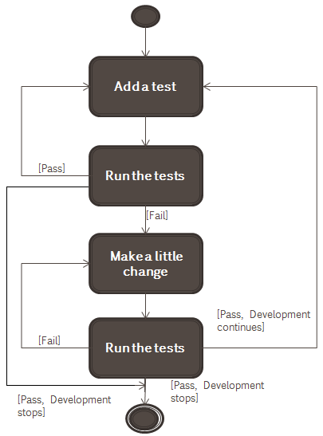
Test Driven Development

Slide 44
Test Driven Development
There are two levels of TDD
Acceptance TDD
Write a single acceptance test, or behavioral specification.
Produce functionality/code to fulfill that test.
Also known as Behavior Driven Development (BDD).
Developer TDD
Write single developer test
Produce code to fulfill that test.
Simply called as TDD

Slide 45
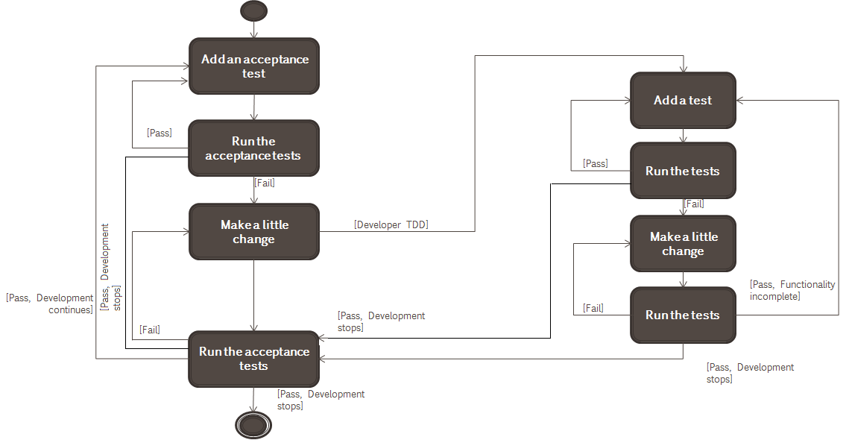
Test Driven Development
Acceptance TDD
Developer TDD

Slide 46
Acceptance TDD vs. Developer TDD
The scenario:
You’re a developer on a team responsible for the company accounting system, implemented in Rails. One day, a business person asks you to implement a reminder system to remind clients of their pending invoices. Because you’re practicing BDD, you sit down with that business person and start defining behaviours.
You open your text editor and start creating pending specs for the behaviours the business user wants:
It "adds a reminder date when an invoice is created"
It "sends an email to the invoice's account's primary contact after the reminder date has passed"
It "marks that the user has read the email"

Slide 47
Acceptance TDD vs. Developer TDD
Some developers prefer to write test cases on the spot, calling methods in the system, setting up expectations, like so:
it "adds a reminder date when an invoice is created"
do
current_invoice = create :invoice
current_invoice.reminder_date.should == 20.days.from_now
End
Let’s look at this a different way, with a Test-Driven Development approach, and write out pending tests:
it "after_create an Invoice sets a reminder date to be creation + 20 business days"
it "Account#primary_payment_contact returns the current payment contact or the client project manager"
it "InvoiceChecker#mailer finds invoices that are overdue and sends the email"

Slide 48
Test Driven Development
Test Case ID | Description | Input Data | Expected Results | Actual Results | Pass / Fail | Remarks
UT001 | To test that the function isDivisibleByThree returns true if any number is divisible by 3 | 3 | True
UT002 | To test that the function isDivisibleByThree returns false if any number is not divisible by 3 | 2 | False
UT003 | To test that the function isDivisibleByFive returns true if any number is divisible by 5 | 5 | True
UT004 | To test that the function isDivisibleByFive returns false if any number is not divisible by 5 | 6 | False
UT005 | To test that the function isDivisibleByFifteen returns true if any number is divisible by 15 | 30 | True
UT006 | To test that the function isDivisibleByFifteen returns false if any number is not divisible by 15 | 25 | False
UT007 | To test that function fizzBuzz returns number if a number is passed to it | 1 | 1
UT008 | To test that function fizzBuzz returns FizzBuzz if a number divisible by 15 is passed to it | 30 | FizzBuzz
UT009 | To test that function fizzBuzz returns Fizz if a number divisible by 3 is passed to it | 9 | Fizz
UT010 | To test that function fizzBuzz returns Buzz if a number divisible by 5 is passed to it | 20 | Buzz

Slide 49
Benefits of Test Driven Development
Code coverage
Every code segment that you write should have at least one associated test. You can be confident that all of the code in the system has actually been executed
Regression testing
Run regression tests to check that changes to the program have not introduced new bugs.
Simplified debugging
When a test fails, it should be obvious where the problem lies. The newly written code needs to be checked and modified. You do not need to use debugging tools to locate the problem
System documentation
The tests themselves act as a form of documentation that describe what the code should be doing.

Slide 50
Test Driven Development Using Standard Libraries
Test-driven development is of most use when development is done by using well-tested standard libraries.
In case of you use libraries, you need to write tests for these systems as a whole
If you use test-driven development, you still need a system testing process to check that it meets the requirements of all of the system stakeholders
System testing also tests performance, reliability, and checks that the system does not do things that it shouldn’t do
Test-driven development is a successful approach for small and medium-sized projects

